Slide 1
WEB

Slide 2
OVERVIEW
The history of the internet and the world wide web.
Fundamental concepts and protocols that support the internet.
About the hardware and software that supports the internet.
How a web page is actually retrieved and interpreted.

Slide 3
WHAT IS THE INTERNET
The internet is a way to allow for computers to communicate together.
Before the internet, most computers where simply isolated machines running their own independent applications.

Slide 4
HISTORY
This existed historically with radios, telegraphs, and telephones, but those were all using analog signals.
These early technologies had very low bandwidth.
Bandwidth is the maximum amount of data that can be transmitted through an internet connection and is measured in bits per second.
A dialup service has a bandwidth of 56kbps and a fiber optic connection has a bandwidth of 10gbps.

Slide 5
PROTOCOLS
A protocol is a set of rules used to manage data exchange between 2 points in a network.
Protocols can include circuit switching, packet switching, or TCP/IP.

Slide 6
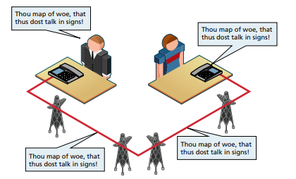
CIRCUIT SWITCHING
One of the earliest protocols was circuit switching, which dedicated a single line to a single call.
This was very inefficient because only one call could be submitted at a time and operators had to physically connect caller to receiver by using a physical switchboard.
The technology was also very noisy, meaning for distant calls, voices would be very faint to hear, and you would often hear other people’s conversations on the line.
The telephone is known as the most valuable patent in history.

Slide 7
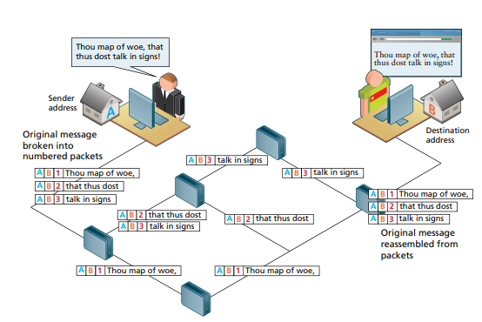
PACKET SWITCHING
In the 1960s, the research network ARPANET used packet switching instead of circuit switching.
Packet-switching did not require a continuous connection. It instead split messages into small chunks called packets and routed them on the least path of resistance.
This method was much more efficient because data lines were now used at a higher rate of utilization.

Slide 8
TRANSMISSION CONTROL PROTOCOL - TCP/IP
By 1981, the TCP/IP protocol became the standard for the internet.
Any organization could connect to this network.
All other protocols became obsolete and this protocol started the birth of the internet.

Slide 9
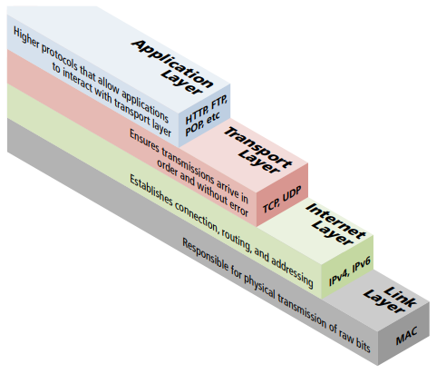
TCP/IP LAYERS
TCP/IP is abstracted as a 4-layer stack.
Layers communicate information up and down one level.
Lower layers handle the more fundamental aspects of transmitting information through a network.
The higher layers handle how a client and server interact.

Slide 10
LINK LAYER
Lowest layer in the TCP/IP protocol.
Responsible for the physical transmission across media through wires.
Responsible for packet creation, transmission, reception, error detection, collisions, and line sharing.

Slide 11
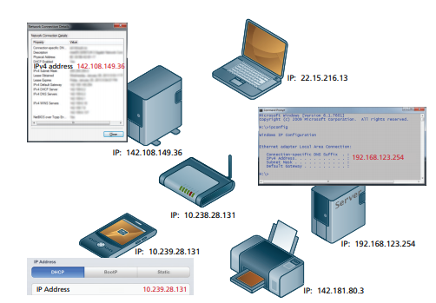
INTERNET LAYER
The internet layer routes packets between communication partners across the network.
It sends the message without any guarantee of a response.
This layer uses internet protocol (IP) addresses to identify destinations on the internet.

Slide 12
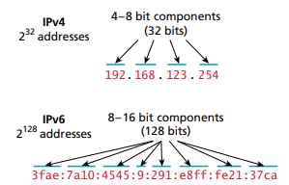
IP ADDRESSES
There are 2 types of IP addresses, IPV4 and IPV6.
Your IP address is assigned by your internet service provider (ISP).
IPV4 limited number of hosts to 4.2 billion, and as more devices were connected to the internet, the number needed to be larger, so IPV 6 was born.

Slide 13
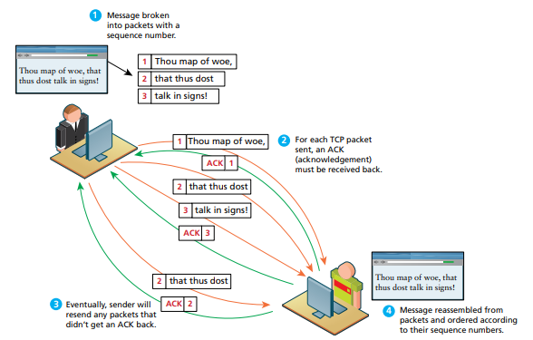
TRANSPORT LAYER
The Transport layer makes sure transmissions arrive in order and without error.
Each packet has a header that includes a sequence number, so the receiver can put the original message back in order, no matter when they arrive.
Each packet received is acknowledged back to the sender in the event of a lost packet, so it can be sent back, and assure that all are in order.

Slide 14
APPLICATION LAYER
The application layer is the highest one and deals directly with the client.
It includes the following protocols:
HTTP: Hypertext Transfer Protocol for web communication.
SSH: Secure Shell Protocol to allow remote command-line connections to servers.
FTP: File Transfer Protocol to transfer files between computers.
POP/IMAP/SMTP: E-mailed related protocols for transferring and storing email.
DNS: Domain Name System protocol for resolving domain names to IP addresses.

Slide 15
BIRTH OF THE WWW
By the late 1980s, the internet began to grow.
At the time, it only contained basic email and text based web pages.
The invention of the world wide web(WWW) transitioned text-only internet into the web applications that we see today.
The WWW was invented in 1990 by Tim Berners-Lee because he was tired of logging in to different computers to find different pieces of information.
In 1994, Tim Berners-Lee founded the World Wide Web Consortium(W3C) which defined the standards of the internet.

Slide 16
WORLD WIDE WEB CONSORTIUM (W3C)
The world wide web consortium (W3C) is the main standards organization for the web.
It promotes compatibility so that web technologies work together in a predictable way.
They provide recommendations and specifications that are meant to guide companies with proper implementations of HTML, XML, and web protocols.
There are over 400 members of the W3C broken up into businesses, government agencies, universities, and professionals.

Slide 17
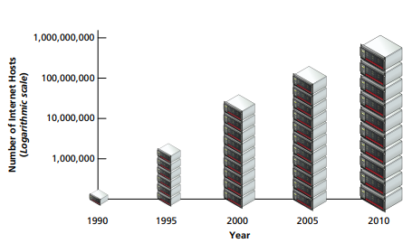
GROWTH OF THE WWW

Slide 18
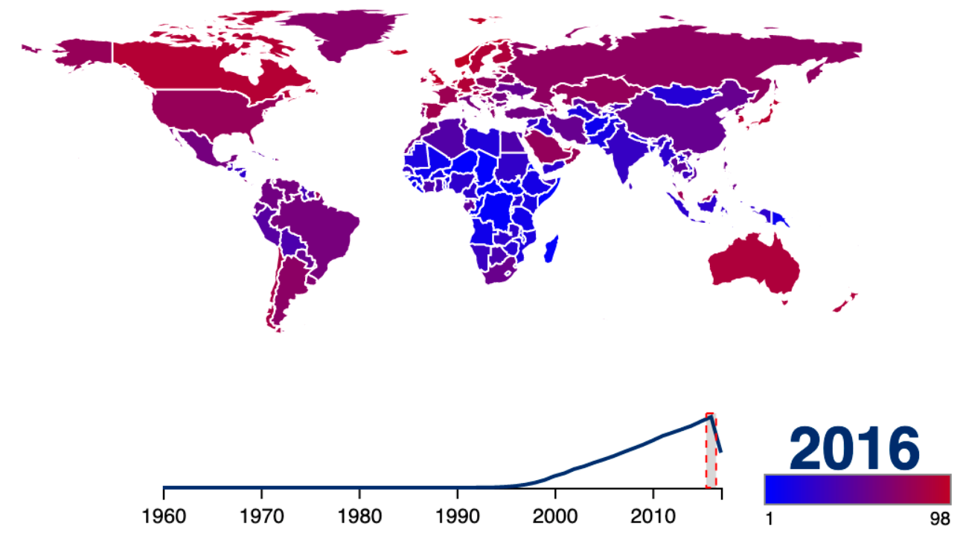
POPULATION USING THE INTERNET

Slide 19
ELEMENTS OF THE WWW
URL: a uniform resource locator to uniquely identify a resource in the web.
HTTP: a hypertext transfer protocol to describe how requests and responses operate.
Server program: a program run server side that responds to HTTP requests.
HTML: hypertext markup language to publish documents.
Browser program: A program run client side that makes HTTP requests from URLs and display the HTML it receives.
Webmaster: Person responsible for creating and supporting a website.

Slide 20
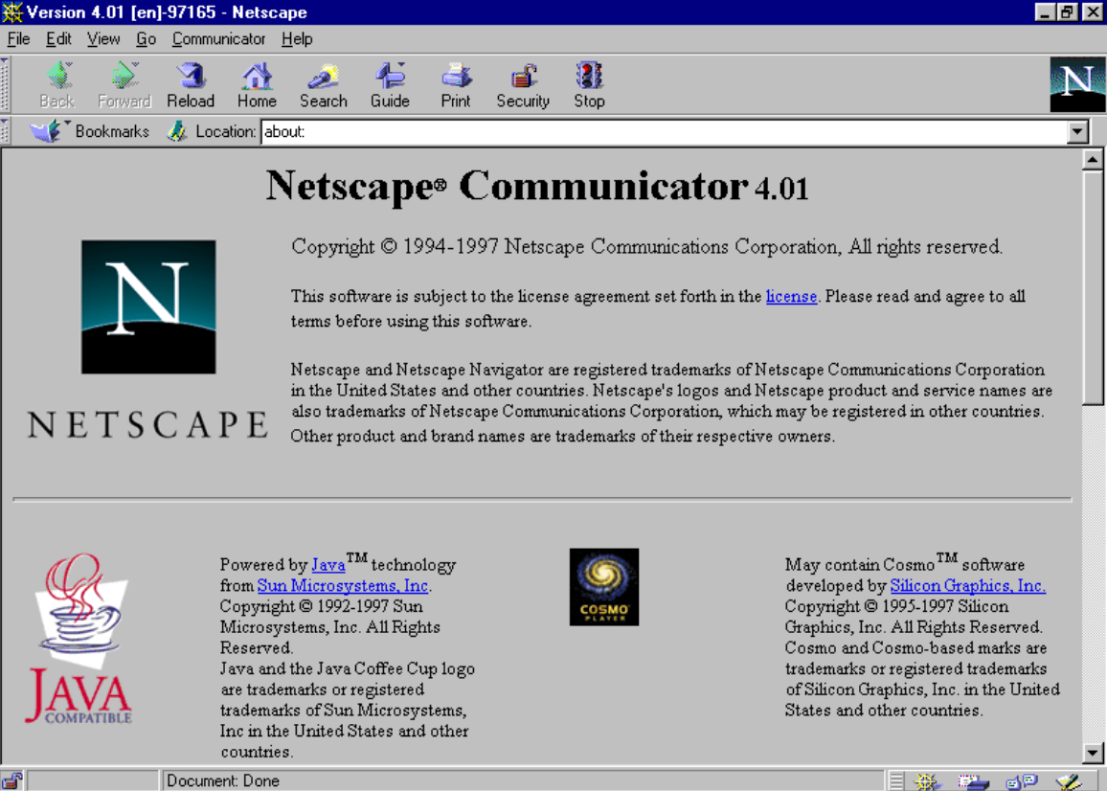
BROWSERS
The first browser was Mosaic, developed by the national center for supercomputing at the University of Illinois.
Marc Andreessen, who worked for that company, later developed Netscape in 1994, which quickly became the primary web browser.
Browsers were then dominated by chrome, IE, Edge, and Firefox.

Slide 21
WEB VS DESKTOP APPLICATIONS
Web and desktop applications both have their own limitations on data storage, user interfaces, and access to the operating system.
As web applications became more sophisticated, they began to replace desktop applications.

Slide 22
ADVANTAGES OF WEB APPLICATIONS
Accessible from anywhere.
Useable with different operating systems and browser applications.
No installation required.
Easier to roll out program updates.
Accessible user data analytics.
Centralized storage.

Slide 23
DISADVANTAGES OF WEB APPLICATIONS
Requires an internet connection.
Transmitted data causes a security issue.
Concerns over storage, licensing, and uploaded data.
Problems with some websites not working right on some browsers.
Restrictions on access to the operating system.

Slide 24
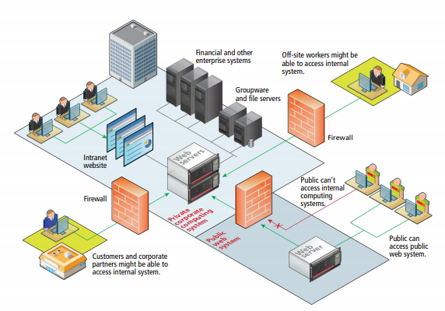
INTRANET
Intranet is a local internet network only accessible within a company.
They are typically protected from unauthorized external access via security features such as firewalls and private IP ranges.

Slide 25
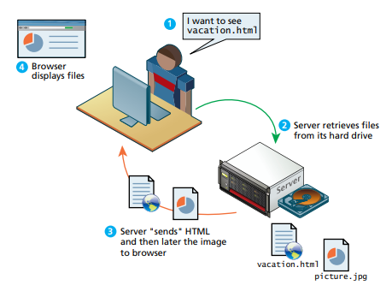
STATIC WEBSITE
Static websites were the first form of websites used on the internet.
Users could read the pages but could not provide feedback.
These websites were mainly used to display information, like a brochure, a company about page, or a series of images. They were not full-stack applications where users could create accounts and log in.
The only knowledge required to create these sites was basic HTML.
Pages looked identical to all users.

Slide 26
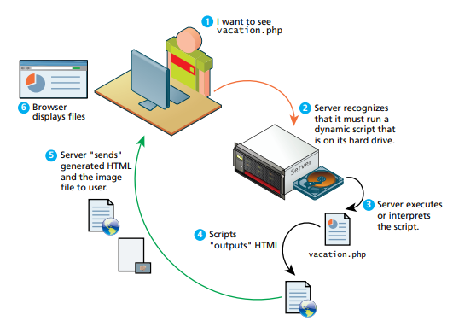
DYNAMIC WEBSITE
Over time, websites became more complicated.
Websites needed to communicate to a database, communicate with financial institutes like paypal, interface with enterprise computer systems, dynamically respond to user input, and have servers output html that would respond to each unique client.
Dynamic websites began the age of full-stack development with the MVC model, giving birth to backend development on web applications.

Slide 27

WEB 2.0
In the mid-2000s, web apps went through a phase called web 2.0, with the development of Facebook, Twitter, and YouTube.
For the users, this meant that they could now post images, comments, and icons into web pages.
For the developer, a new paradigm of development had begun. SPA frameworks like React, Angular, and Vue began to revolutionize the web development process.

Slide 28
LOOKS VS FUNCTION
Web 2.0 made software companies realize that their teams needed both designers and programmers to build successful apps on the internet.
Steve Jobs always said that the aesthetics i.e. looks is just as important as the function.
Looks can be objective and are not always subjective, especially with the accepted standards of consistency, symmetry, and organization.
Looks should never be sacrificed at the cost of function. For example, the Titanic limited life boats because it cluttered the looks of the ship. Also, glass is often still used on smart phones because it looks good, but has a tendency to crack, and can be just as easily replaced with plastic.

Slide 29
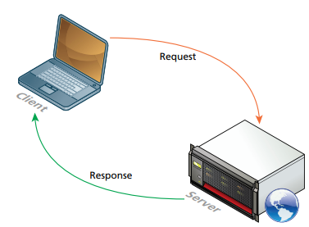
CLIENT-SERVER MODEL
The web uses the client-server model of communication.
The server is a computer agent that is normally active 24 hours a day, 7 days a week, listening for queries from any client that makes a request.
The client is a computer agent that makes requests and receives responses from the server, in the form of response codes, images, text files, and other data.

Slide 30
CLIENT
Client machines are desktops, laptops, smart phones, and tablets.
They house the web browsers that is familiar to the user.
They make requests to servers using URLs.

Slide 31
SERVER
The server is a central hub to the client-server model.
It hosts web applications, database systems, and performs security authorization tasks.
It stores data such as documents, images, and videos.
It listens to requests from the client and sends a response, through a request-response loop.

Slide 32
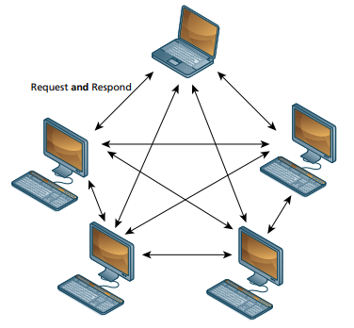
PEER-TO-PEER MODEL
In contrast to the client-server model, the peer-to-peer model uses every computer the same way, either as a server or client.
Each node is able to send and receive data directly with one another.
Neither is required to be connected 24/7.
Video chat and bit torrent protocols are examples of this model.

Slide 33
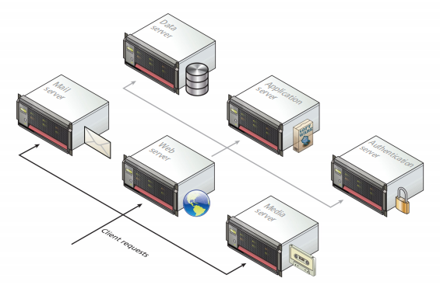
SERVER TYPES
Most websites are served from more than one server.
These servers can include web servers, application servers, database servers, mail servers, media servers, and authentication servers.

Slide 34
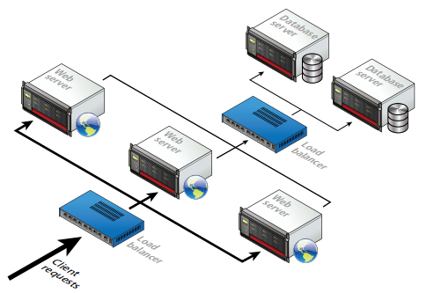
SERVER INSTALLATIONS
In many popular applications like Facebook, a busy website may receive thousands of requests per seconds.
To handle this, a server farm is used.
These farms distribute incoming requests between clusters of machines, so that no server is excessively loaded.
Load balancers are used to distribute this load.
There is also failover redundancy, where one server handles the load if one of the replicated server fails.

Slide 35
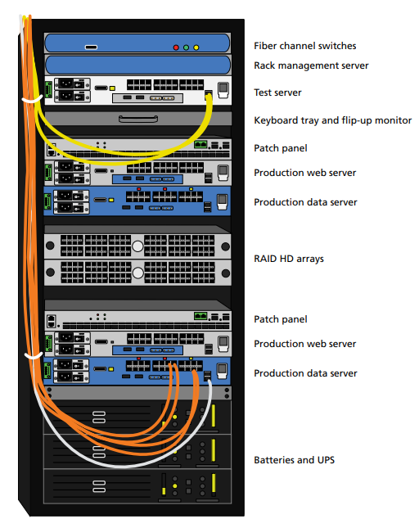
SERVER INSTALLATIONS
Servers do not look like computers in your house.
It will consist of many racks stacked on top of each other.
They are housed in special facilities called data centers.
These facilities will contain more than computers and hard drives, but also sophisticated air conditioning systems, redundancy power systems, and security personnel.

Slide 36
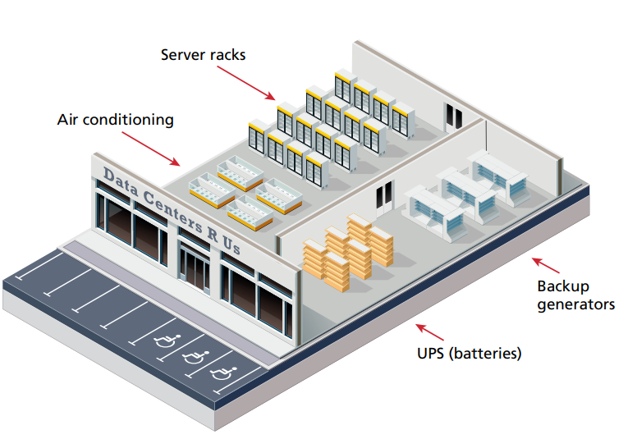
SERVER INSTALLATIONS

Slide 37
SERVER INSTALLATIONS
To prevent sites from going down, large companies will mirror their data centers in different parts of the world.
As a consequence, the costs of multiple data centers are high, especially from infrastructure and electricity costs.
Most small to mid-size web companies will lease space from third party data centers.

Slide 38

CLOUD
It’s commonly acceptable that the internet be visually represented as a cloud.
For many, the internet seems to lack a concrete physical manifestation beyond our computer and cell phone screens.

Slide 39
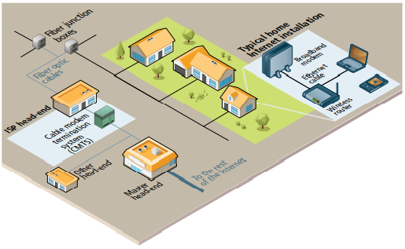
INFRASTRUCTURE OVERVIEW
The internet is a series of devices that work in unison to properly allow communications between computers.
The broadband modem is a bridge between the hardware of a cable company to the hardware inside a home.
These devices are supplied by the ISP.

Slide 40
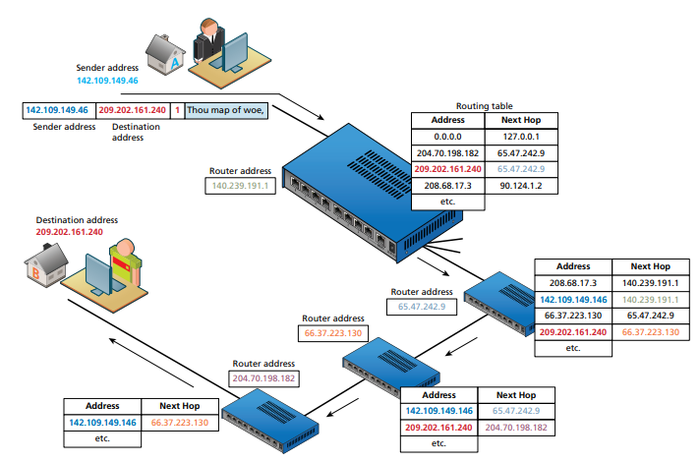
ROUTERS
Routers are the most important devices to make the internet work.
Routers forwards data packets from one network to another.
Routers use routing tables and next-hop routing, in which the router only knows the address of the next step in the path, and leaves it to the next router to continue routing to its final destination.

Slide 41
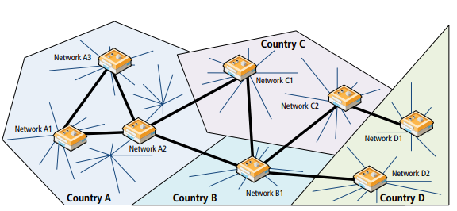
INTERNATIONAL INTERNET
Every country has it’s own network system.
The fewer router hops, the quicker the response.
Not every network access point (NAP) node can interconnect with another country.
In some cases, even if 2 nodes are very close to each other physically like C1 and C2, they might have to travel thousands of miles to A1 to properly connect.
This system in the 1990s was very inefficient, especially that most NAPs existed in the United States.

Slide 42
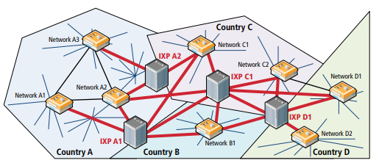
INTERNET EXCHANGE POINTS
In the 2000s, these networks improved using an internet exchange point (IXP), which allowed more nodes to peer with each other.
By using IXP, countries C and D no longer need to hop out of their country for domestic communications.
These IXPs exist in major cities such as Palo Alto, Amsterdam, Frankfurt, and London.

Slide 43
INTERNET EXCHANGE POINTS
IXPs connect to other networks but also to large websites such as Microsoft and Facebook.
Large website companies duplicate their servers at a location near an IXP for faster transportation.
By connecting company data centers close to IXPs, bandwidth and performance is improved.

Slide 44
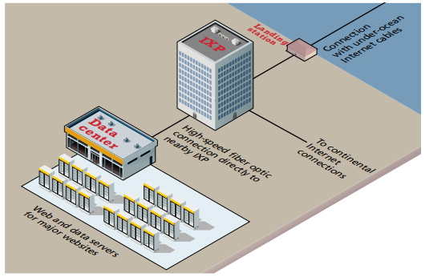
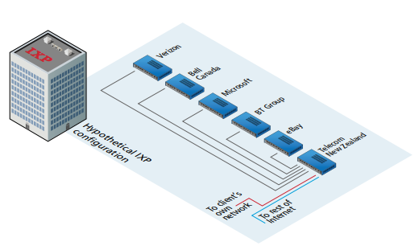
INTERNET EXCHANGE POINTS

Slide 45
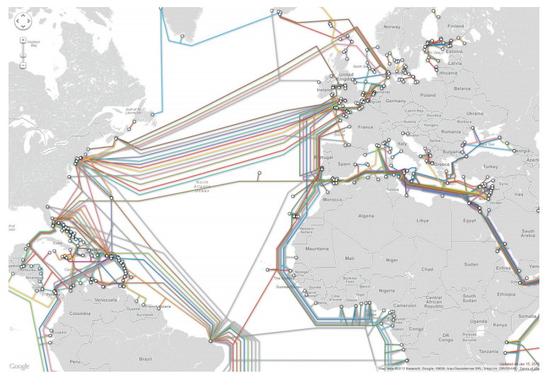
UNDERWATER EXCHANGE
Over 250 undersea fiber optic cable systems operate by a variety of different companies across the globe.
For countries not serviced by underwater cable, such as Antarctica and small islands, internet connectivity is provided by orbiting satellites.
Satellites have a much smaller bandwidth but also account for a small percentage of oversea communication.

Slide 46
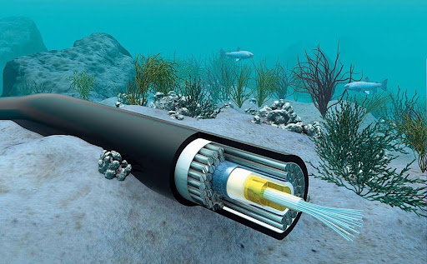
UNDERWATER EXCHANGE

Slide 47
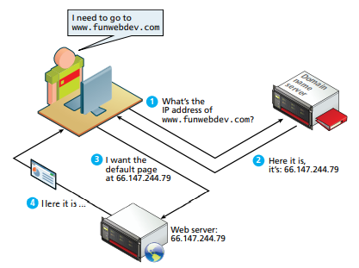
DOMAIN NAME NOMENCLATURE
It’s not intuitive to remember IP addresses like 173.194.33.32 instead of a domain name like www.google.com, so key-value pair domain name/ip addresses were invented.
One benefit to key-value pairs is that the name can stay the same even if the IP address is changed.
As the number of domain names increased, the domain name system (DNS) was invented.
The process occurs on every request but is extremely fast, especially with caching.

Slide 48
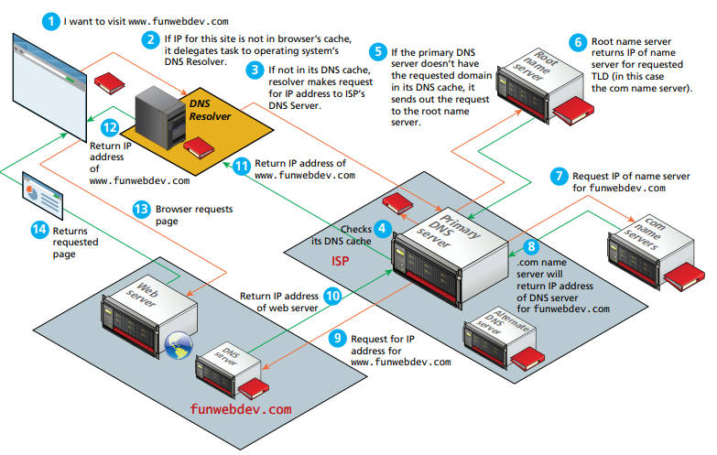
DETAILED ADDRESS RESOLUTION PROCESS

Slide 49
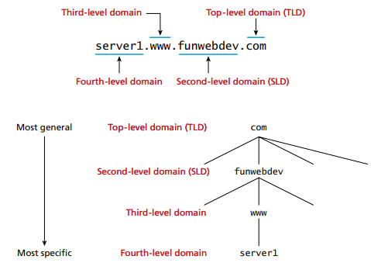
NAME LEVELS
The domain names are split with a dot.
The tokens from right to left go from more general to more specific.

Slide 50
GENERIC TOP LEVEL DOMAIN (TLD)
Unrestricted: includes .com, .net, .org, and .info.
Sponsored: includes .gov, .mil, and .edu (these domains must have permissions from sponsor before acquiring new address).
New: includes .apple, .google, and .mcdonalds (as of 2012, companies could submit applications for new TLDs).
Country-based: includes .us, .ca, .uk, and .au (these TLDs are under the control of the countries they represent, and use the internationalized top-level domain name (IDN) system for language characters that are recognizable with the english alphabet, such as chinese, greek, arabic, or japanese).

Slide 51
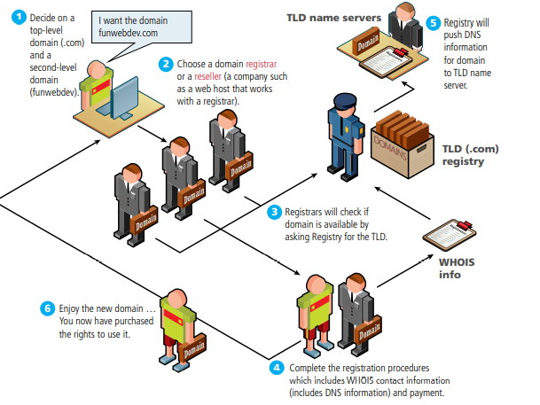
NAME REGISTRATION
The domain name registrars manage the registration of domain names.
The internet corporation for assigned names and numbers (ICANN) oversees the management of top-level domains, in a process shown in the diagram.

Slide 52
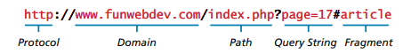
UNIFORM RESOURCE LOCATORS (URL)
The uniform resource locator (URL) is used to request particular resources from the web.
It consists of the protocol, the domain (or IP address), the path, the query string, and the fragment.

Slide 53
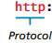
PROTOCOL
The protocol is the 1st token of the URL and requests for the application protocol.
Requesting ftp://... sends an FTP request to port 21, while requesting http://... transmits on port 80.

Slide 54
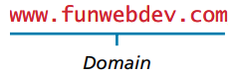
DOMAIN
The domain is the 2nd token of the URL and identifies the server from which we are requesting resources.
The domain is case insensitive.
A port# is sometimes added to the end of the domain to connect specifically to a port outside the default port of the domain. For instance, to connect to port 888 specifically, the URL would look like http://funwebdev.com:888/.

Slide 55
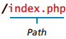
PATH
The path is used to drill down on the specific folder/file from the root of the website stored on the server.
The path is usually case sensitive but can be insensitive if using windows servers.
If a path is not provided, the server will default to the root file, which is usually index.html, index.php, Default.html, or Default.aspx.

Slide 56
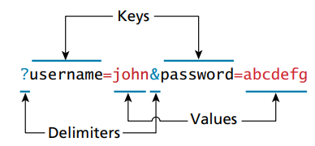
QUERY STRING
Query strings are a way of passing parameters from the client to the server.
In URLs, they are encoded as key-value pairs delimited by ‘&’ and preceded by ‘?’.

Slide 57
HYPERTEXT TRANSFER PROTOCOL (HTTP)
HTTP is the protocol for the world wide web, as opposed to SSH for file transfers.
If a request is successful, the server returns a response with code, headers, and an optional message.
The user experience of web apps is different than desktop apps, because web apps don’t download or install software, they use the URL to access an app, and facilitated with the browser.
The browser parses the HTML, CSS, and JavaScript.

Slide 58
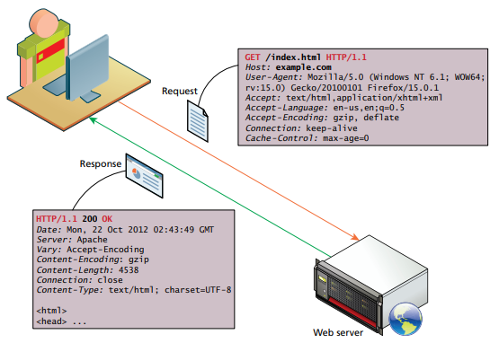
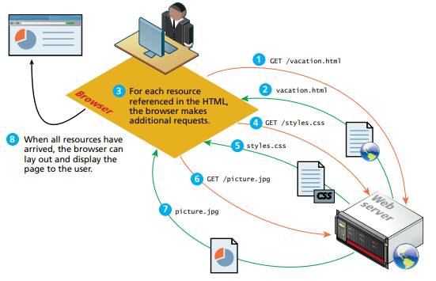
HYPERTEXT TRANSFER PROTOCOL (HTTP)

Slide 59
HEADERS
Headers are parameters that are part of the request and response on every HTTP transaction.
There are dozens of request and response headers but only a selected few will be covered.

Slide 60
REQUEST HEADERS
Host: Specifies server which domain this IP address is requesting.
User-Agent: Specifies operating system and browser the user is running.
Accept: Specifies server media type the client can receive.
Accept-Encoding: Specifies types of modifications that can be done on data before transmission.
Connection: Specifies whether server should keep the connection open or close.
Cache-Control: Allows client to control caching mechanisms.

Slide 61
RESPONSE HEADERS
Server: Specifies the server to the client, such as operating system and browser.
Last-Modified: Specifies when requested resource last changed.
Content-Length: Specifies how large the response body will be.
Content-Type: Specifies data type attached to the body of the message.
Content-Encoding: Specifies how content is encoded.

Slide 62
REQUEST METHODS
Request methods are used to ask for specific characteristics during an HTTP transaction.
They include PUT, DELETE, CONNECT, TRACE, and OPTIONS, but the most popular ones are GET and POST.

Slide 63
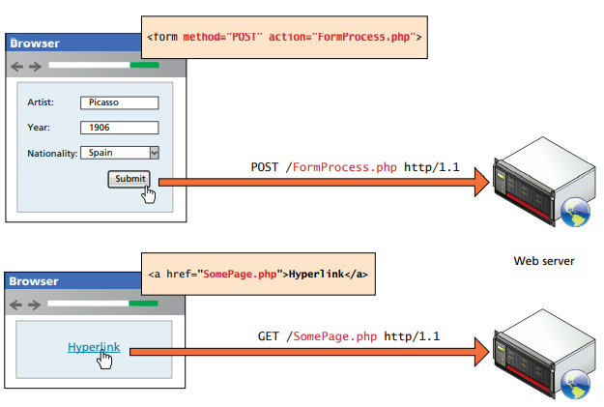
REQUEST METHODS
A GET request asks for a resource located at a specific URL to be retrieved.
A POST request is normally used to transmit data to the server. In a POST request, data is transmitted through the header of the request, and is not subject to length limitations with GET. Also, since the data is not transmitted through the URL, it is safer to transmit.

Slide 64
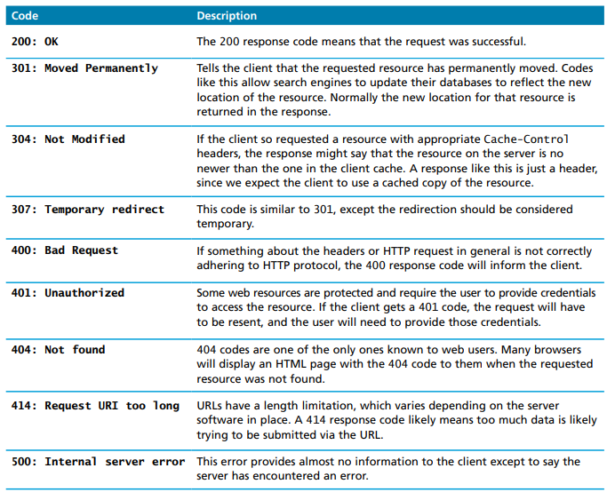
RESPONSE CODES
Response codes are integer values returned by the server as part of the response header.
These codes describe the state of the request, whether it was successful, had errors, or requires permission.
The codes use the 1st digit to indicate the category of the response. For instance, 2## codes are successful responses, 3## codes are redirection responses, 4## codes are client errors, and 5## codes are server errors.

Slide 65
WEB APP INFRASTRUCTURE
Before deploying a web app, the engineer has to make decisions on web servers, operating systems, server software, database software, and scripting software.
All hardware and software must work in unison for proper integration, efficiency, concurrency, reliability, and security.

Slide 66
WEB SERVERS
A web server is a computer that responds to HTTP requests.
The 1st web server was hosted on Tim Berners-Lee’s desktop.
Industrial web servers are more powerful than your home computer because they are more redundant, reliable, and replaceable.
Sometimes web engineers pick a particular stack because of personal preference over rationale.
This class uses the LAMP stack, including Linux OS, Apache web server, MySQL database, and PHP scripting language.
Another popular stack is the WISA stack, includes the Windows OS, IIS web server, SQL Server Database, and the ASP.NET server-side development technologies.

Slide 67
OPERATING SYSTEM
The choice of operating systems will limit the software applications that can be installed.
Linux is often preferred because of higher uptime, lower memory requirements, easier to customize, and easier to remotely administer the machine from the command line.
Linux is also free, making it attractive to professionals and students who are starting out.

Slide 68
WEB SERVER SOFTWARE
The 2 most popular web server software applications are Apache and IIS.
Apache is the Linux version and can run on windows, linux, and mac, so it is platform agnostic.
IIS is the windows version and is used for those who prefer the .NET development framework. Many use IIS to access other microsoft products such as ASP.NET and SQL Server.

Slide 69
DATABASE SOFTWARE
The moment your website is dynamic, instead of static, it will require a database.
The most common open source is SQL, whereas the common proprietary choices are Oracle, and IBM DB2.
Mongo has become more popular than SQL in recent years, primarily for being semi-structured and flexible to accommodate the wild west of internet data.
All of these databases are capable of managing large amounts of data, maintaining integrity, and responding to many queries.

Slide 70
SCRIPTING SOFTWARE
Scripting software is used to process the HTTP requests sent from the client.
In the LAMP stack, the languages are usually PHP, Python, or Ruby on Rails.
In the WISA stack, the ASP.NET family using C# are most common.

Slide 71
WEB OBSOLESCENCE
The internet changes all the time, it’s very important to keep all packages up to date.
For instance, on 05/30/22, gmail no longer allowed external apps to send emails through gmail. Meaning if your historical apps relied on the gmail SMPT to send emails, they would all be no longer working.
Also, on 12/31/20, flash was no longer supported for security reasons. Meaning if your website had flash animations, they would no longer work.

